Slide 1

Tools for contextualizing human brain maps
Vincent Bazinet

Slide 2

Tools for contextualizing human brain maps
Vincent Bazinet
Ross D. Markello

Slide 3
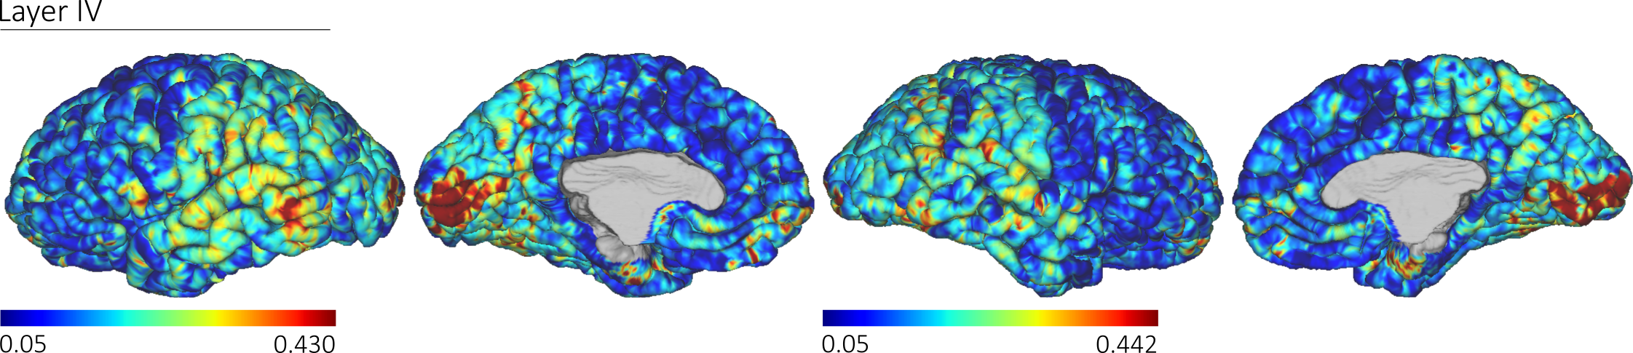
Contextualizing human brain maps
What do we mean by “contextualizing”?
Is our map enriched for specific biological entities or processes:
Gene expression
Neurotransmitter receptors
metabolism,
Cell types
Neurophysiological oscillation
Etc.
1

Slide 4


Contextualizing human brain maps
What do we need to contextualize our brain map?
Toolbox to make easy, statistically-rigorous comparisons between brain maps
Python interface for fetching and working with the Allen Human Brain Atlas (AHBA) microarray expression data
2

Slide 5
Contextualizing human brain maps
What do we need to contextualize our brain map?
Toolbox to make easy, statistically-rigorous comparisons between brain maps
Python interface for fetching and working with the Allen Human Brain Atlas (AHBA) microarray expression data
2

Slide 6
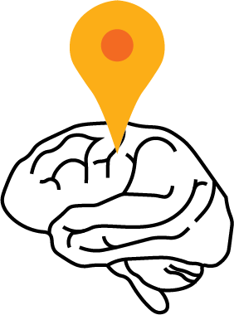
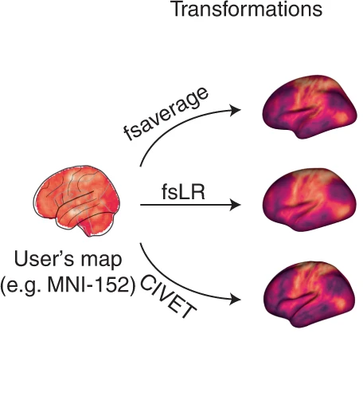

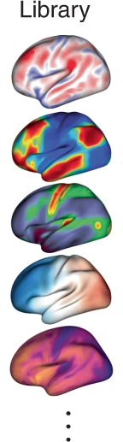
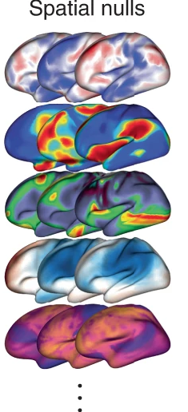
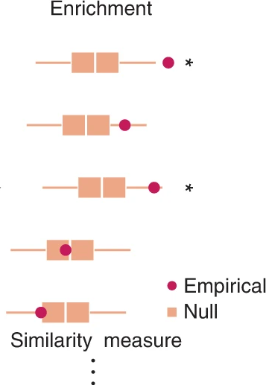
neur maps: the workflow
3

Slide 7
neur maps: transforms
3

Slide 8
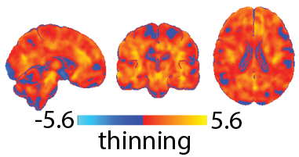
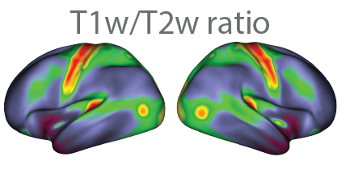
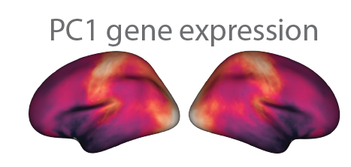
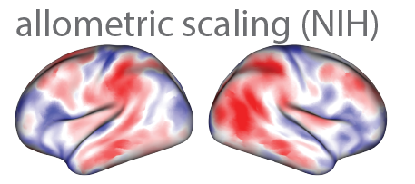
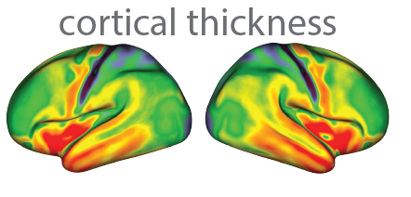
neur maps: transforms
Let’s say we have a brain map in MNI152 space
cortical thinning (schizophrenia):
and we want to compare it to other brain maps:
Neuromaps User Guide | Coordinate systems
4

Slide 9
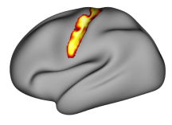
neur maps: transforms
Let’s say we have a brain map in MNI152 space
cortical thinning (schizophrenia):
and we want to compare it to other brain maps:
fsLR surface
Neuromaps User Guide | Coordinate systems
4

Slide 10
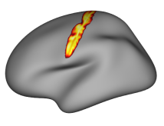
neur maps: transforms
Let’s say we have a brain map in MNI152 space
cortical thinning (schizophrenia):
and we want to compare it to other brain maps:
fsLR surface
fsaverage surface
Neuromaps User Guide | Coordinate systems
4

Slide 11
neur maps: transforms
Let’s say we have a brain map in MNI152 space
cortical thinning (schizophrenia):
and we want to compare it to other brain maps:
fsLR surface
~32k vertices
fsaverage surface
~10k vertices
CIVET surface
~41k vertices
We need to transform brain maps between coordinate systems
Neuromaps User Guide | Coordinate systems
4

Slide 12
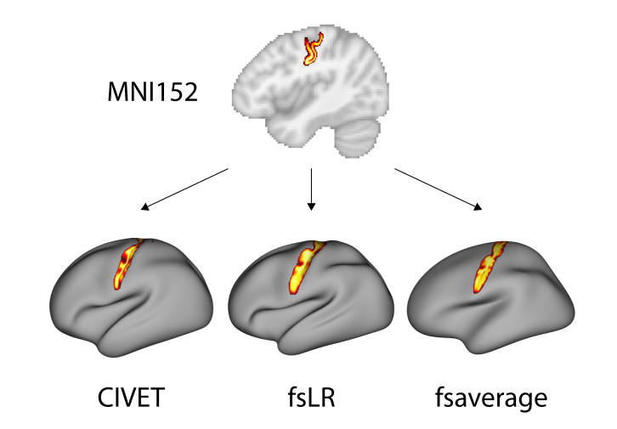
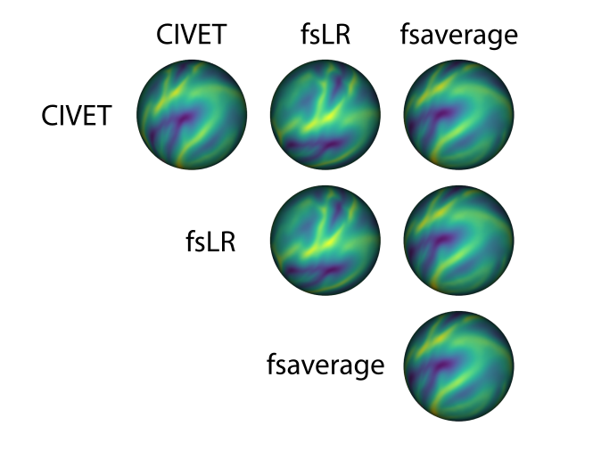
neur maps: transforms
We need to transform brain maps between coordinate systems
the registration fusion framework:
(from volume to surface)
Multimodal surface matching:
(from surface to surface)
Neuromaps User Guide | Transformations between coordinate systems
5

Slide 13
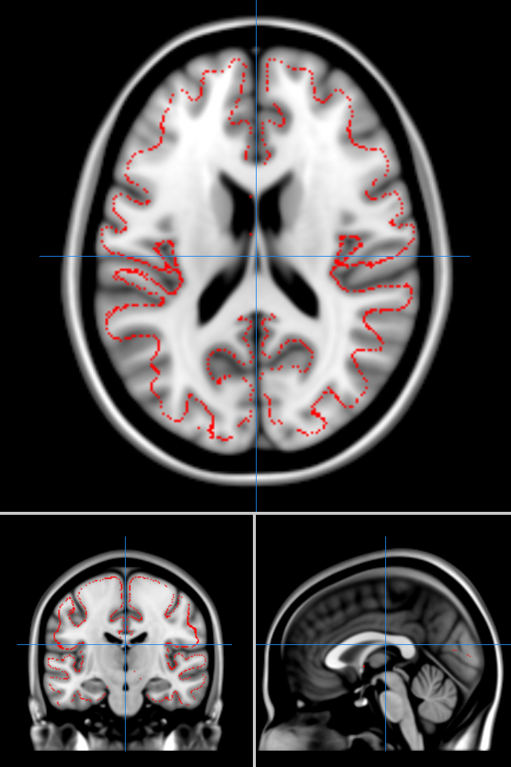
neur maps: transforms
We need to transform brain maps between coordinate systems
the registration fusion framework:
(from volume to surface)
1) map subject’s native image to MNI152 space
2) map subject’s native image to fsaverage space
3) concatenate the two to get a mapping from MNI152 space to fsaverage space
[mapping generated using data from the HCP S1200 release]
Code for generating the registration fusion mappings available in the neuromaps-dev git-hub repo
6

Slide 14
neur maps: transforms
We need to transform brain maps between coordinate systems
the Multimodal surface matching framework:
(from surface to surface)
1) Take descriptors of brain structure and function for our “source” coordinate system
2) Map it to the spherical surface mesh of our “source” coordinate system
3) Align the spherical surfaces of our “source” and “target” systems based on the descriptors of brain structure and function
4) Use the “deformed” spherical surface to map brain maps from our system to another
7

Slide 15
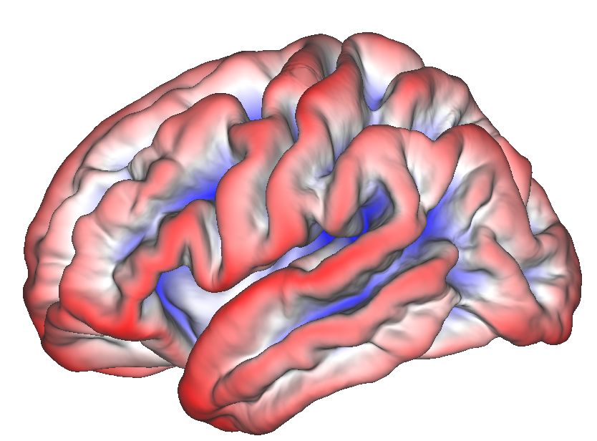
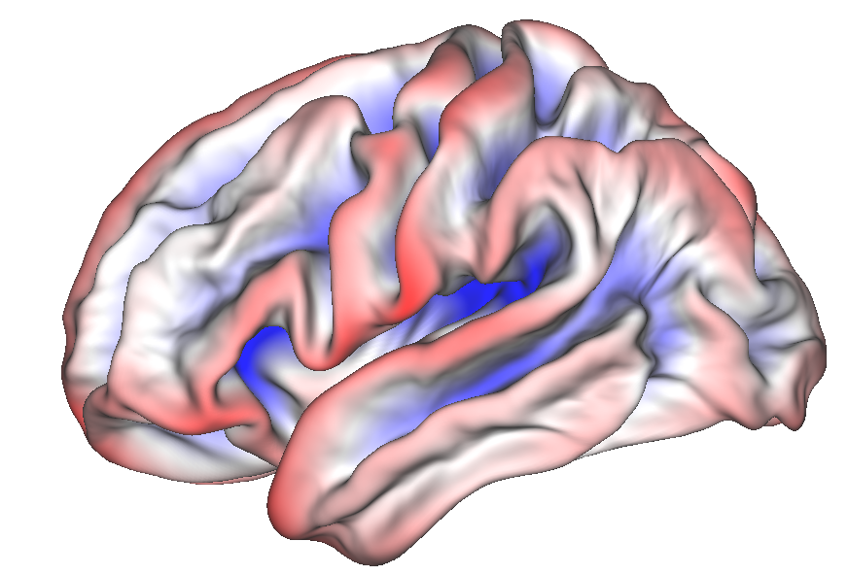
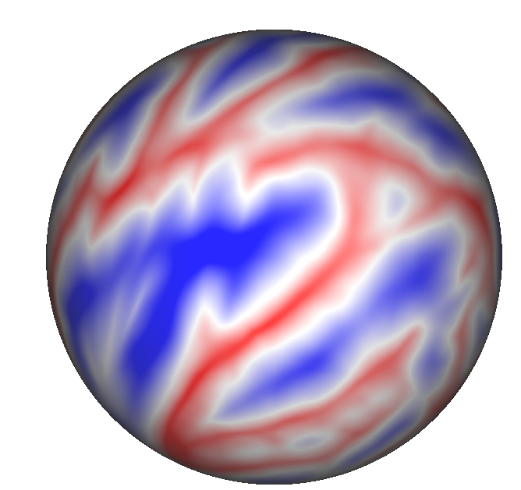
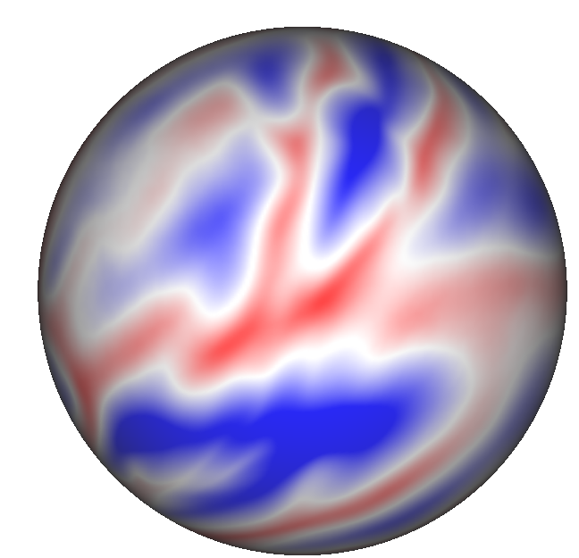
neur maps: transforms
Multimodal surface matching framework
from fsaverage…
…to fsLR
sulcal depth information
sulcal depth information
pial mesh
midthickness mesh
fsaverage
fsLR
We want to align the two brain maps
spherical mesh
spherical mesh
fsaverage
fsLR
8

Slide 16

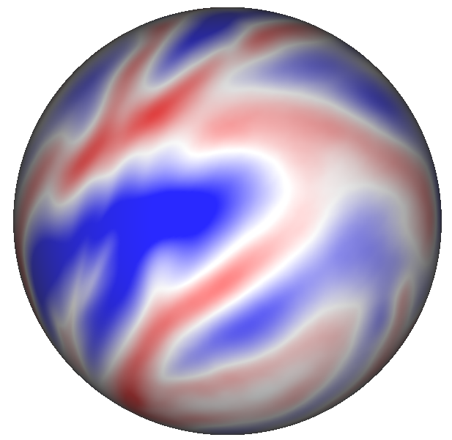
neur maps: transforms
Multimodal surface matching framework
from fsaverage…
…to fsLR
sulcal depth information
sulcal depth information
pial mesh
midthickness mesh
fsaverage
fsLR
spherical mesh
fsLR deformed to fsaverage
spherical mesh
until they match each other
rotate the sphere
spherical mesh
fsaverage
fsLR
8

Slide 17
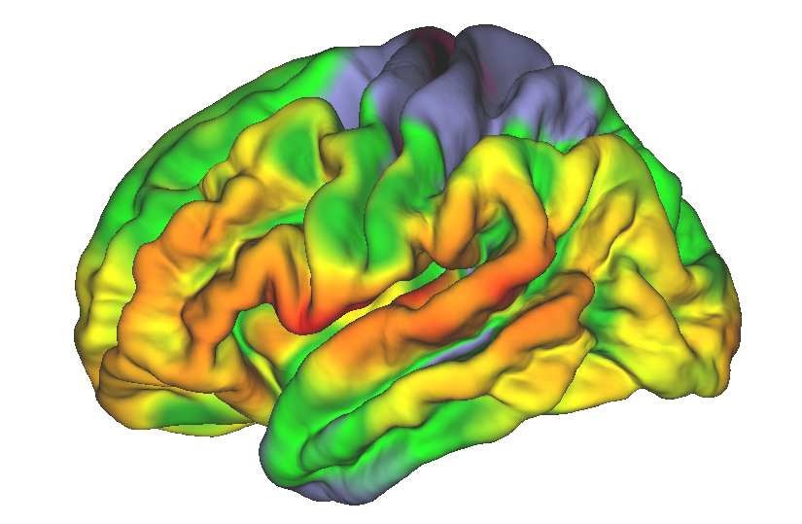
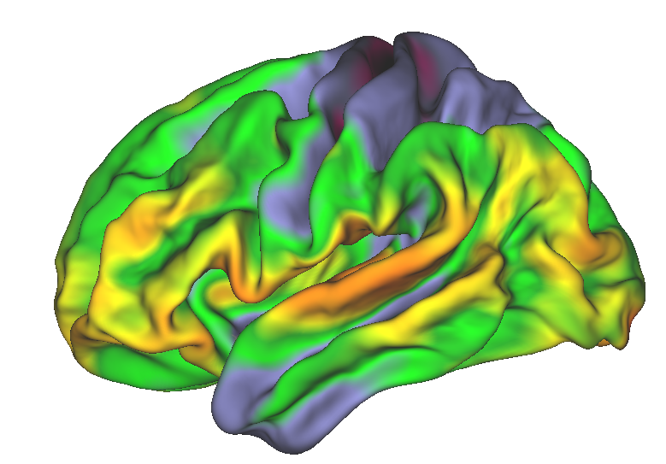
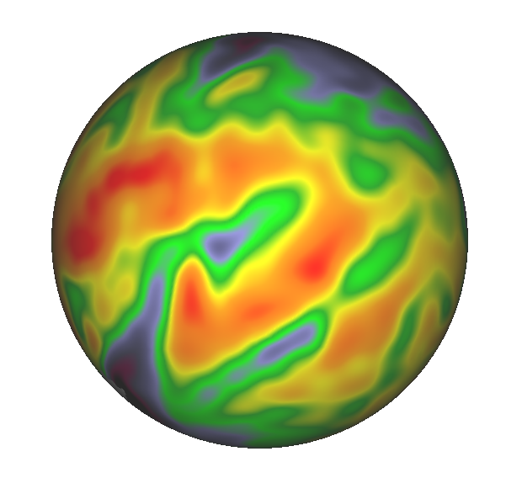
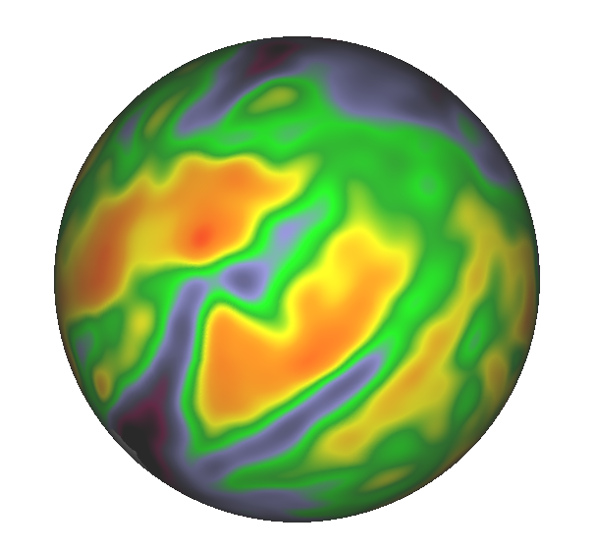
neur maps: transforms
Multimodal surface matching framework
from fsaverage…
…to fsLR
GABAa receptor density (Norgaard et al., 2021)
GABAa receptor density (Norgaard et al., 2021)
pial mesh
midthickness mesh
fsaverage
fsLR
spherical mesh
fsLR deformed to fsaverage
spherical mesh
fsaverage
8

Slide 18
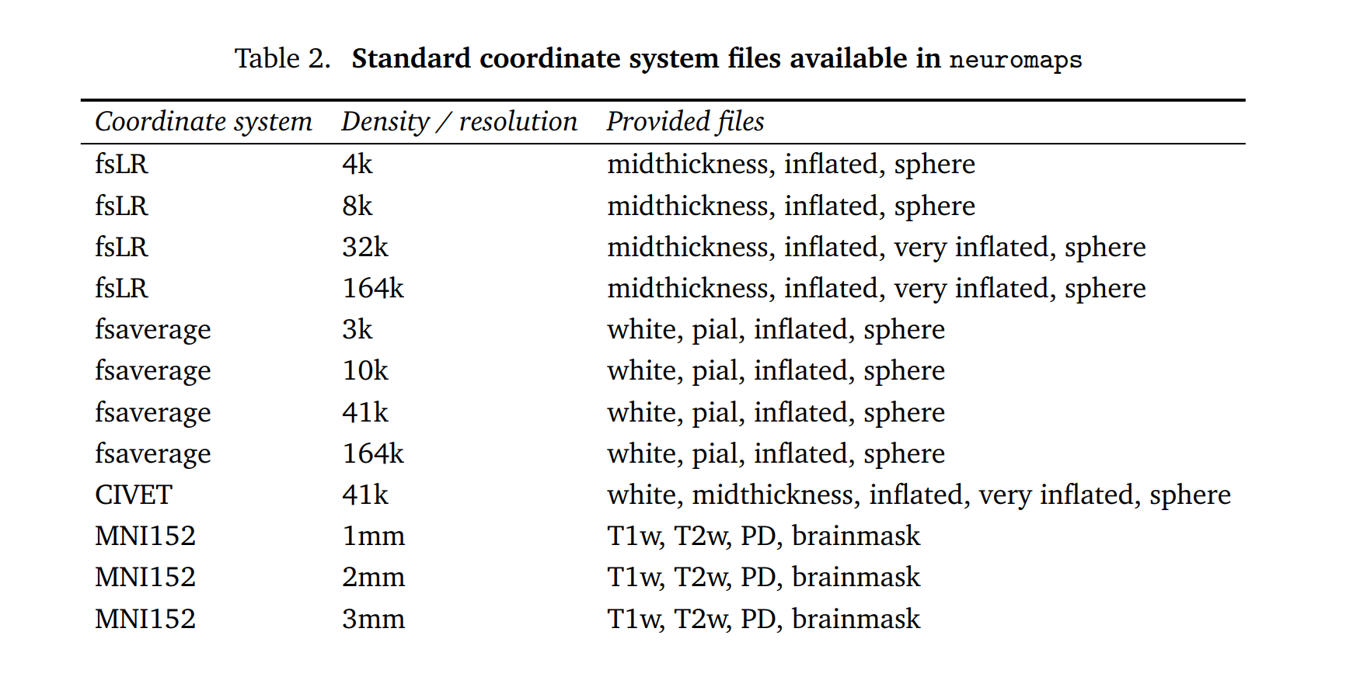
neur maps: transforms
8

Slide 19
neur maps: datasets
9

Slide 20
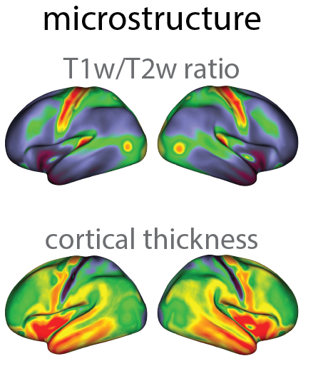
neur maps: datasets
Van Essen et al., 2013 Neuroimage
10

Slide 21
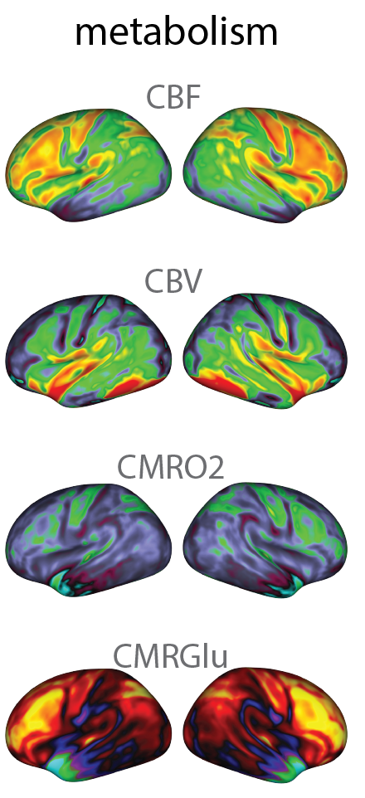
neur maps: datasets
Vaishnavi et al. (2010) PNAS | Satterthwaite et al. (2014) PNAS
10

Slide 22
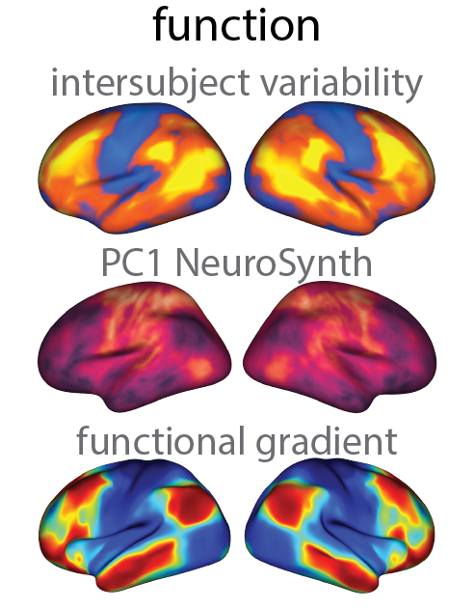
neur maps: datasets
Mueller et al. (2013) Neuron | Yarkoni et al. (2011) Nature Methods | Margulies et al. (2016) PNAS
10

Slide 23
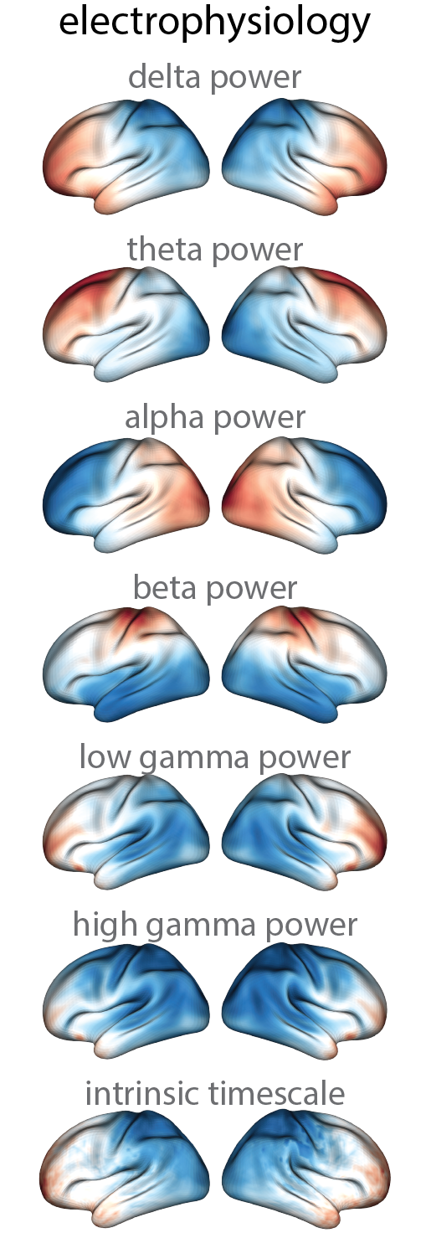
neur maps: datasets
Van Essen et al., 2013 Neuroimage
10

Slide 24
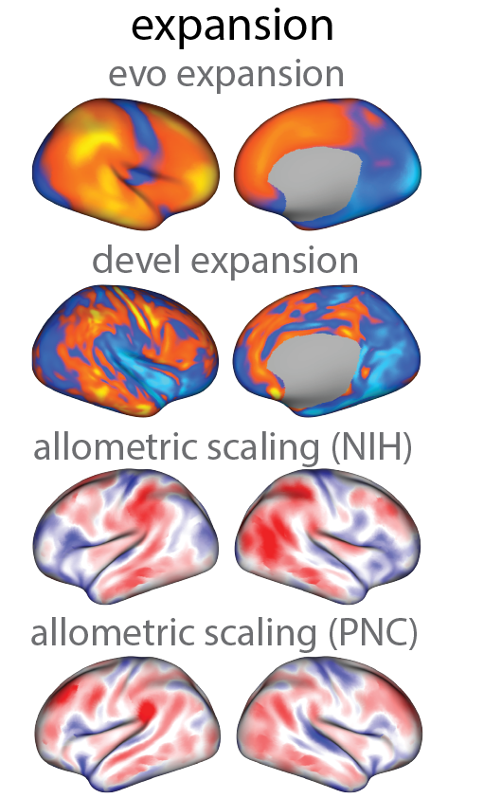
neur maps: datasets
Hill et al. (2010) PNAS | Reardon et al. (2018) Science
10

Slide 25
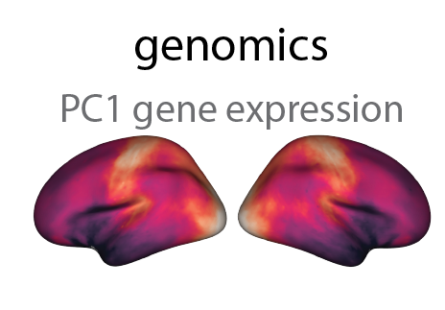
neur maps: datasets
Hawrylycz et al. (2012) Nature
10

Slide 26
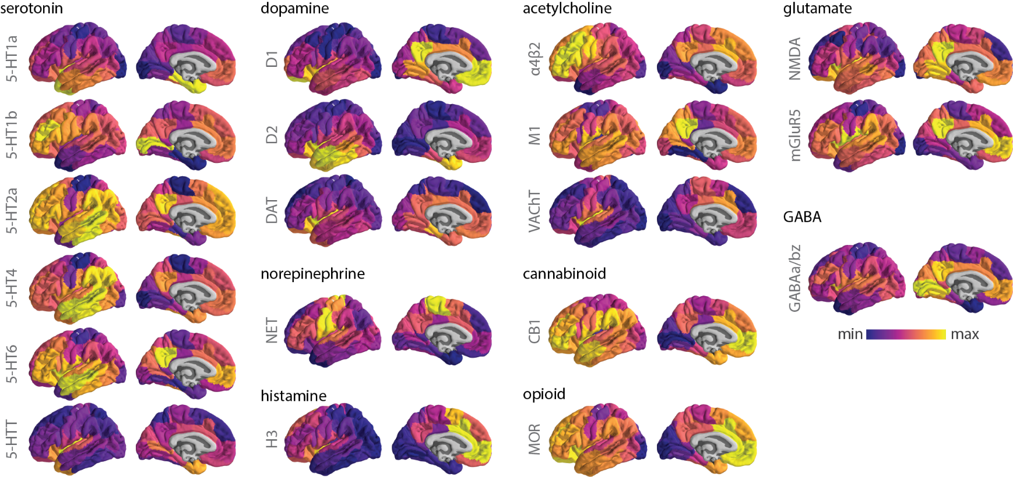
neur maps: datasets
Hansen et al. (2022) Nature Neuroscience
10

Slide 27
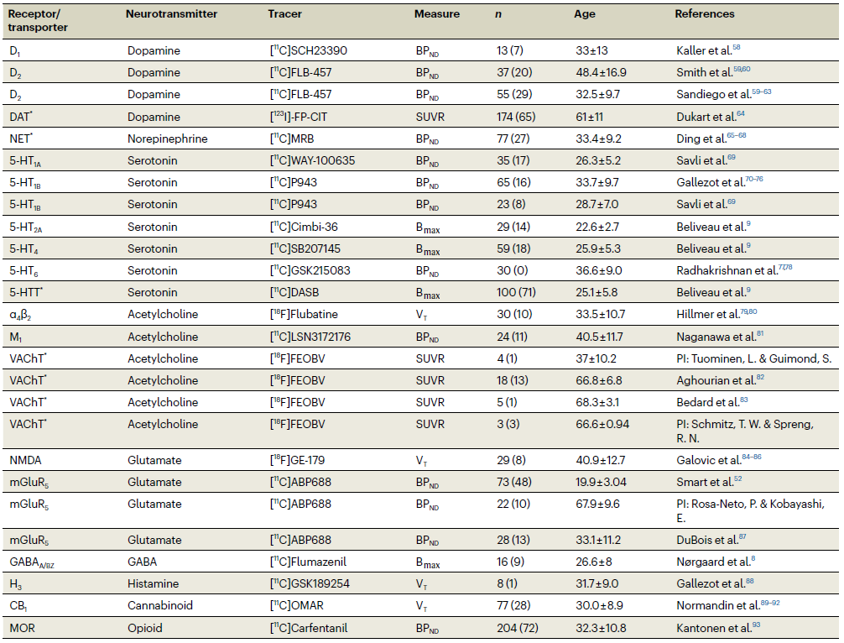
neur maps: datasets
Hansen et al. (2022) Nature Neuroscience
11

Slide 28
neur maps: spatial nulls
12
Notes:
Beginning of slide: 17:00

Slide 29
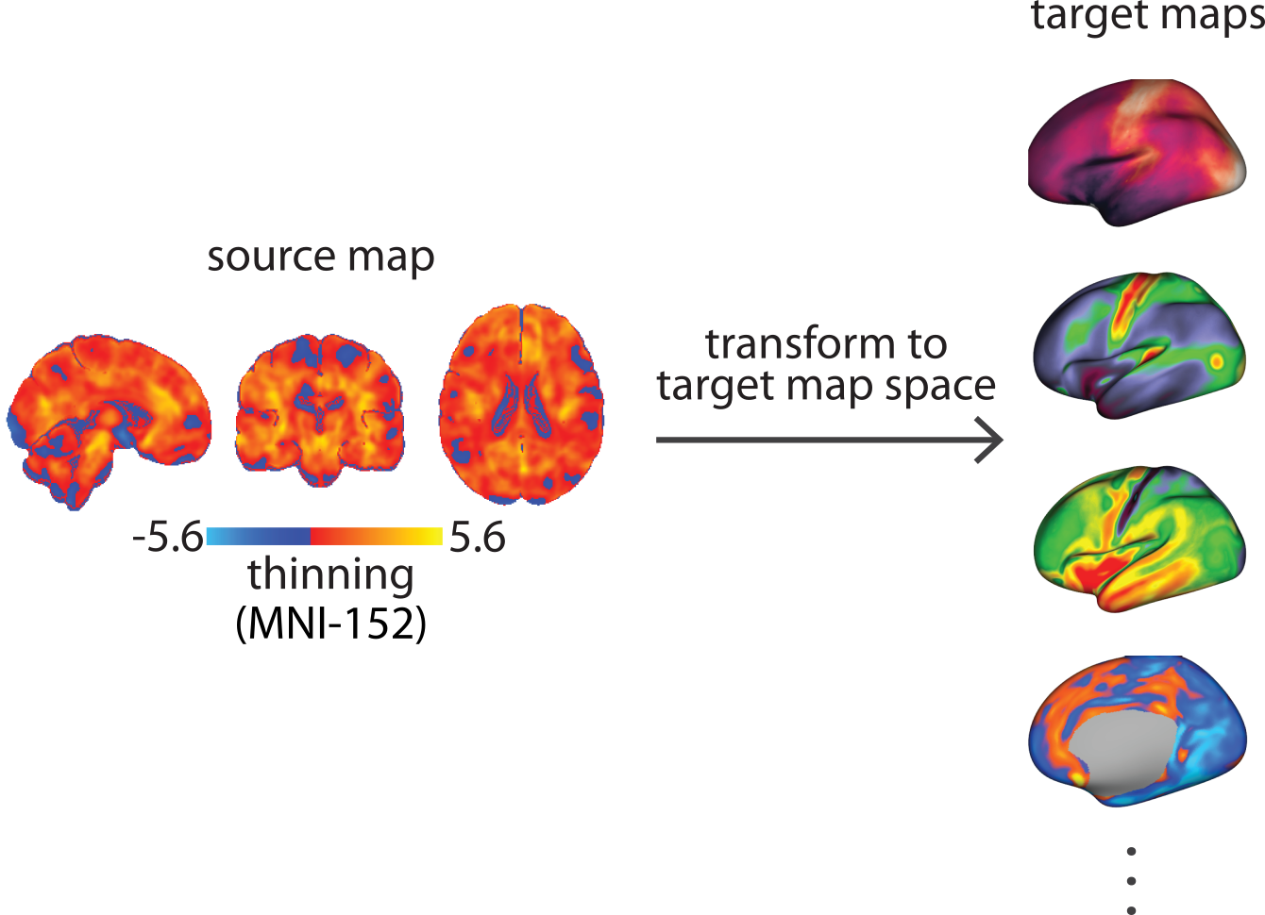
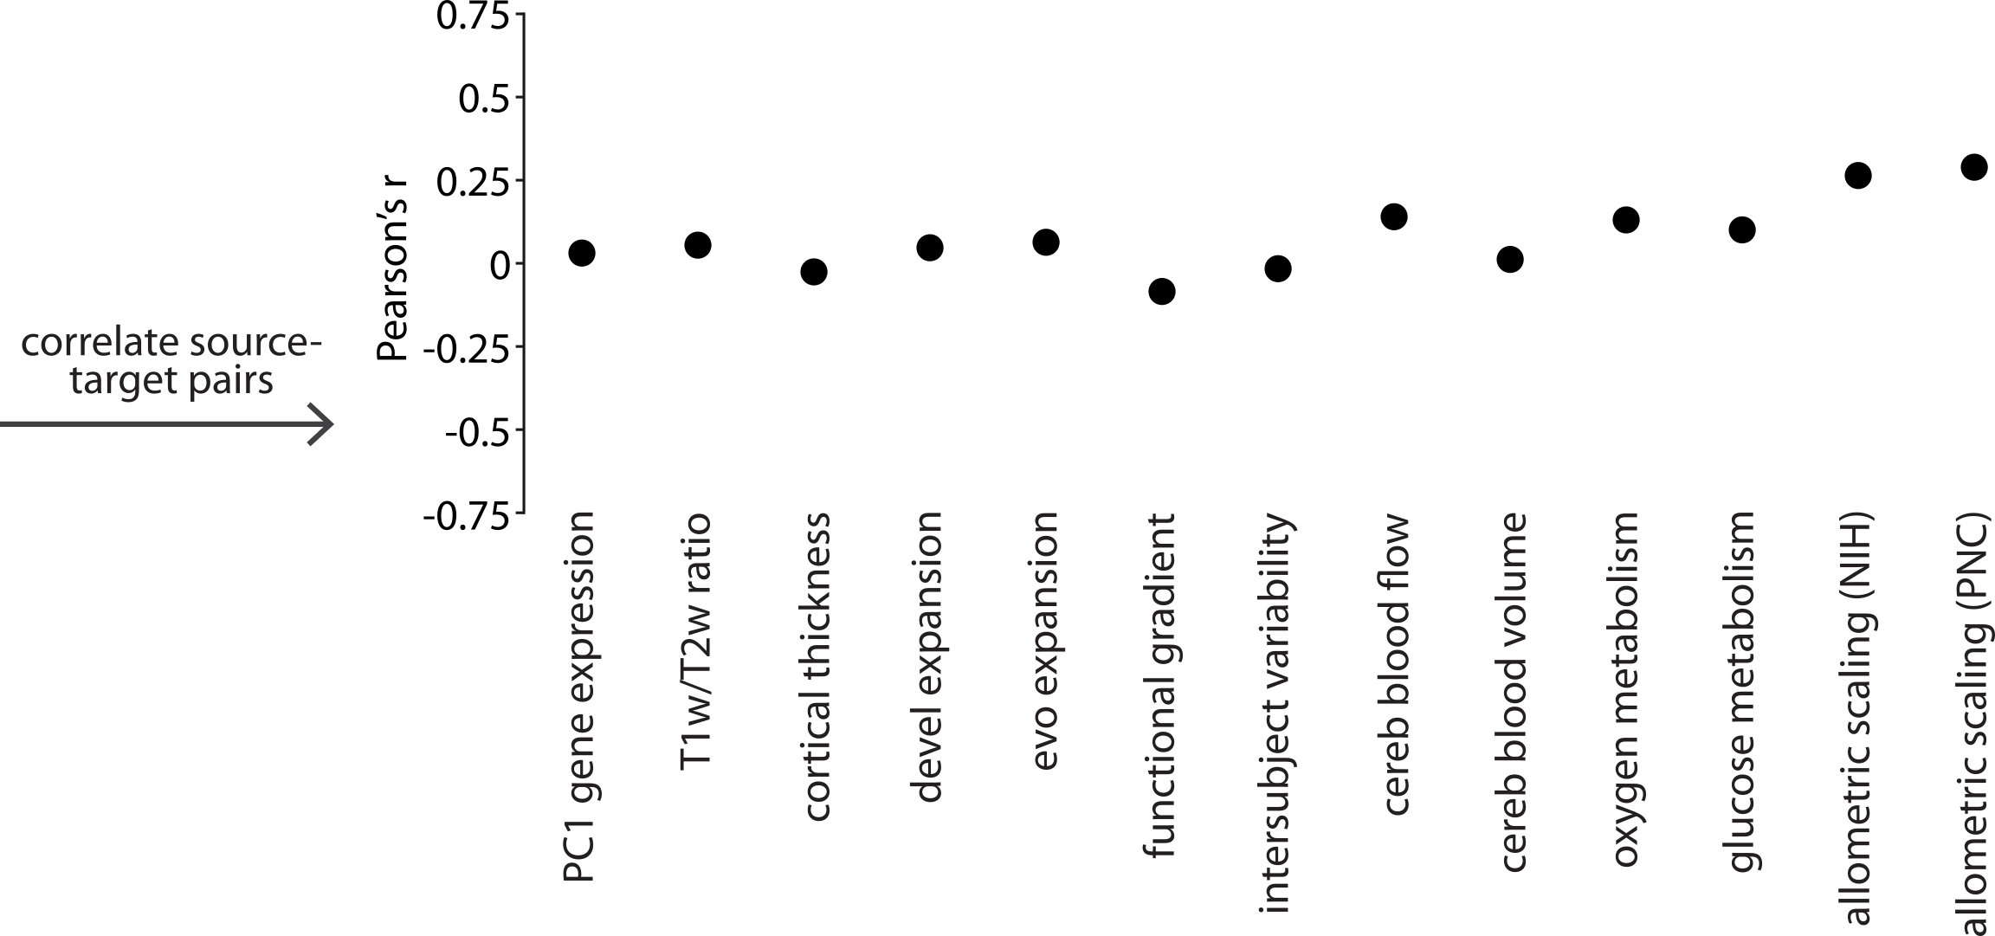
neur maps: spatial nulls
How do we contextualize brain maps?
How do we evaluate the significance of the results obtained?
13

Slide 30
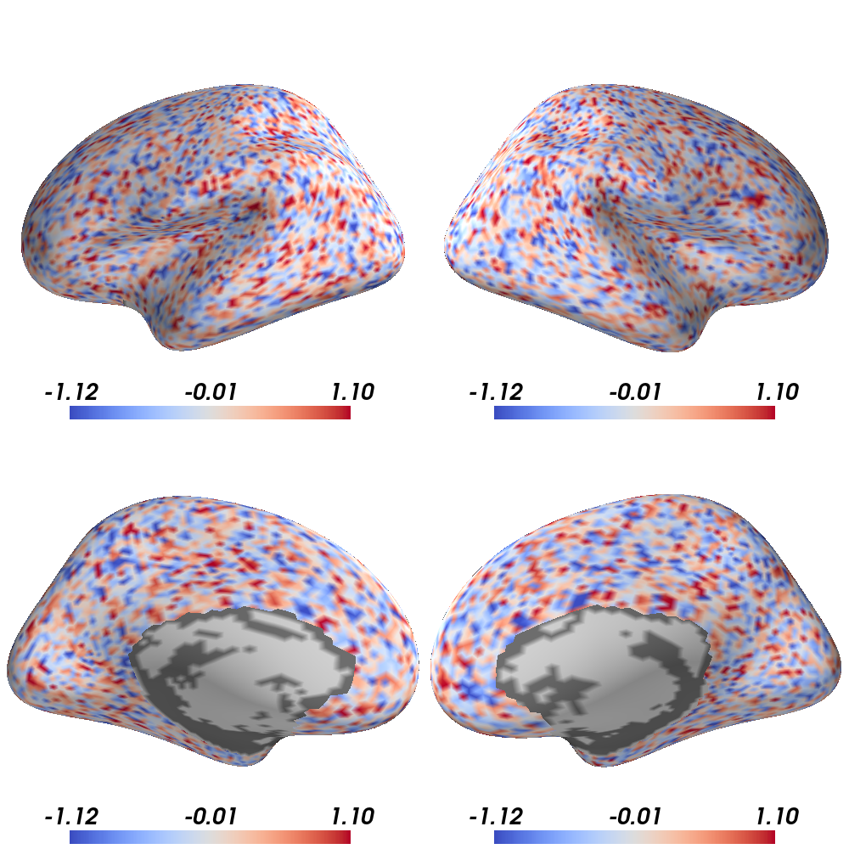
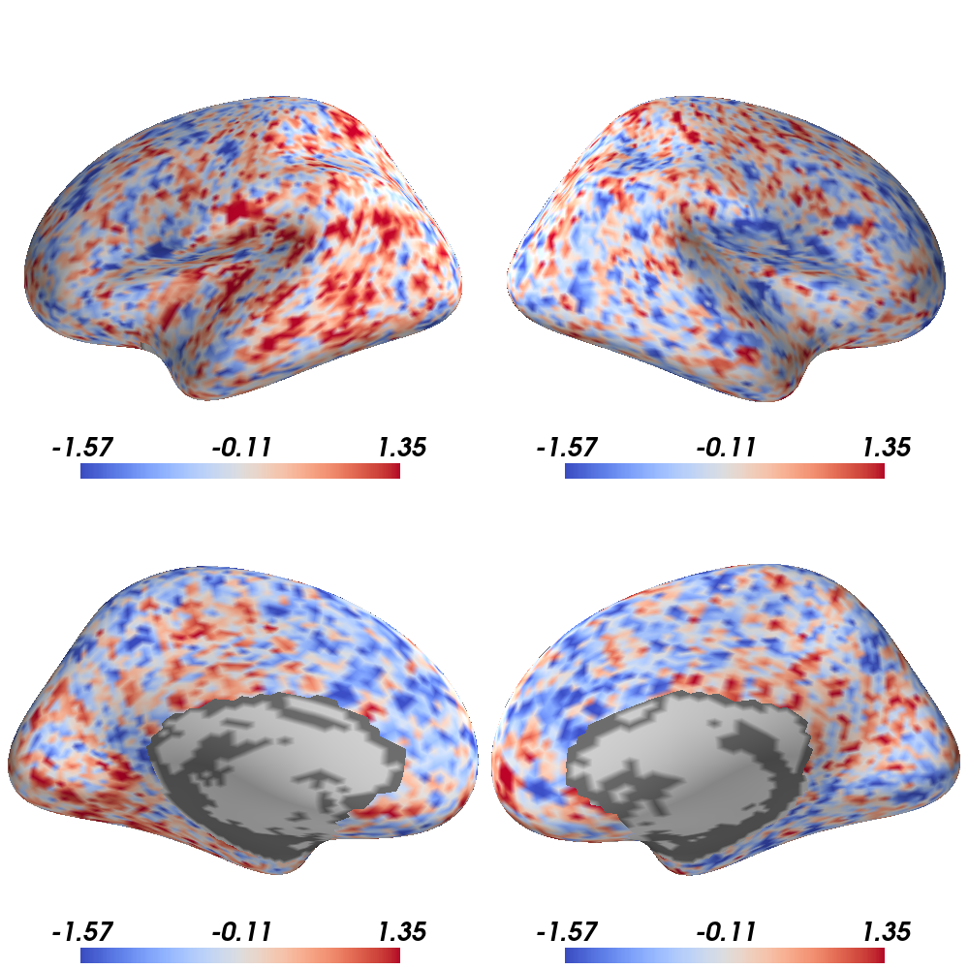
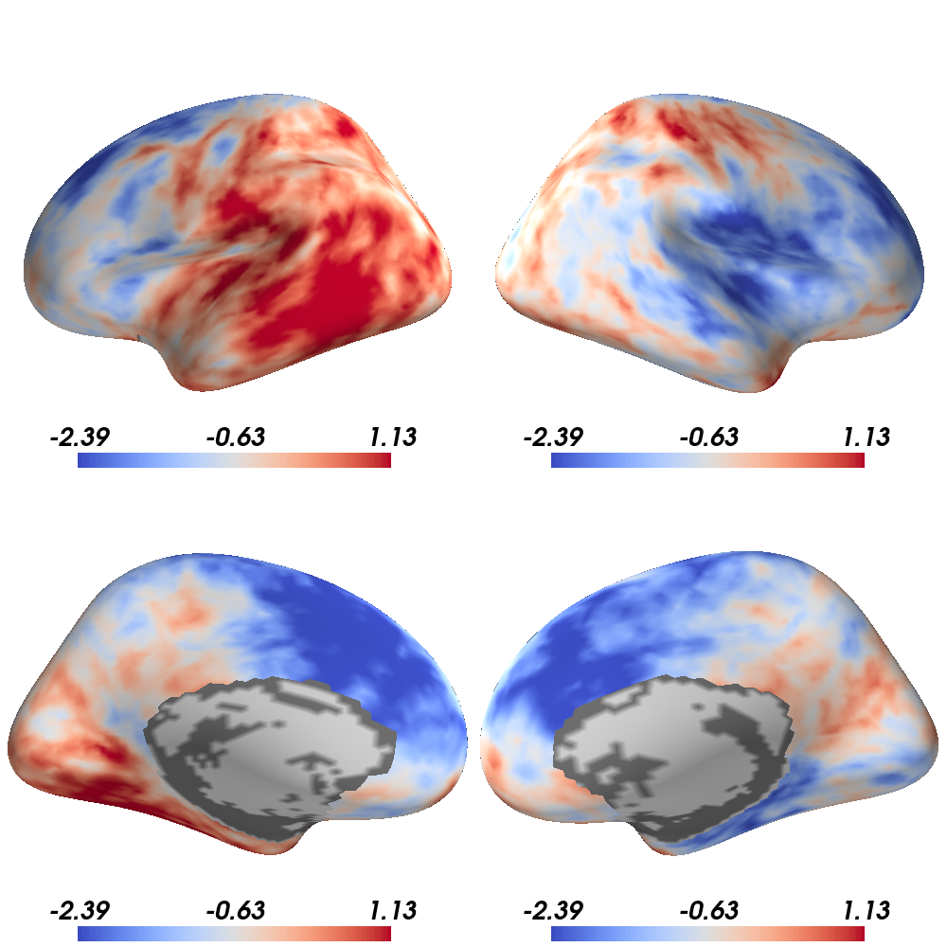
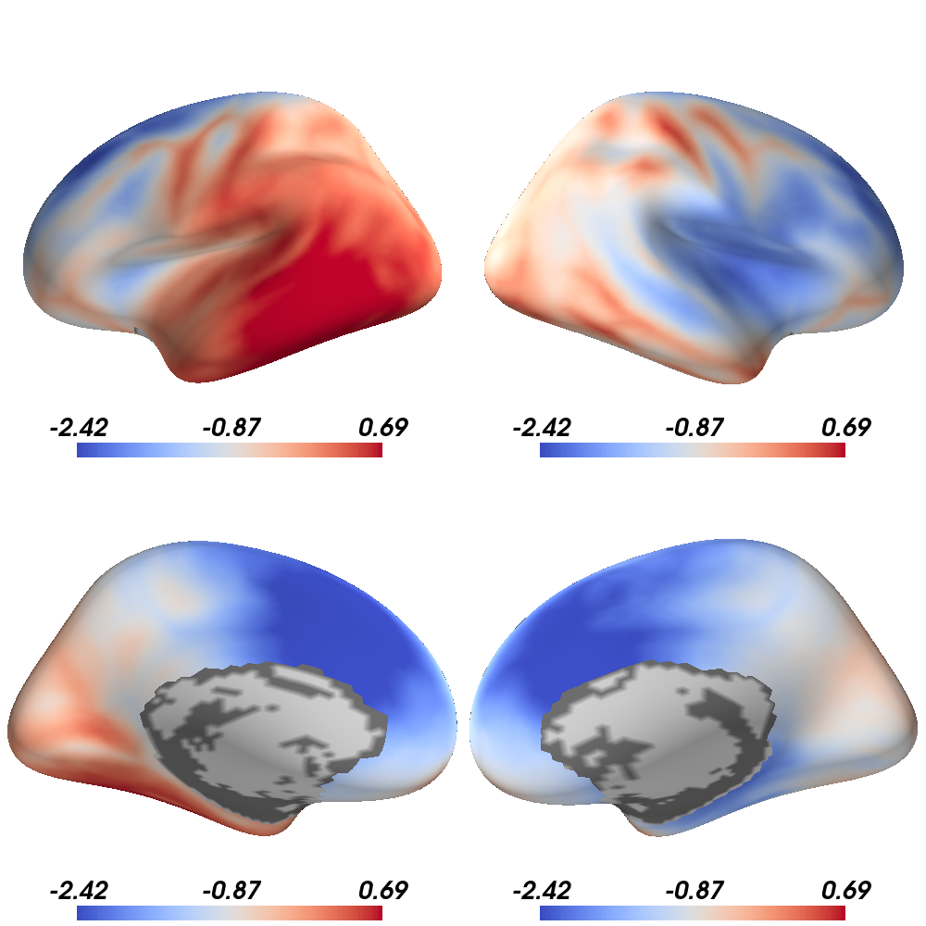
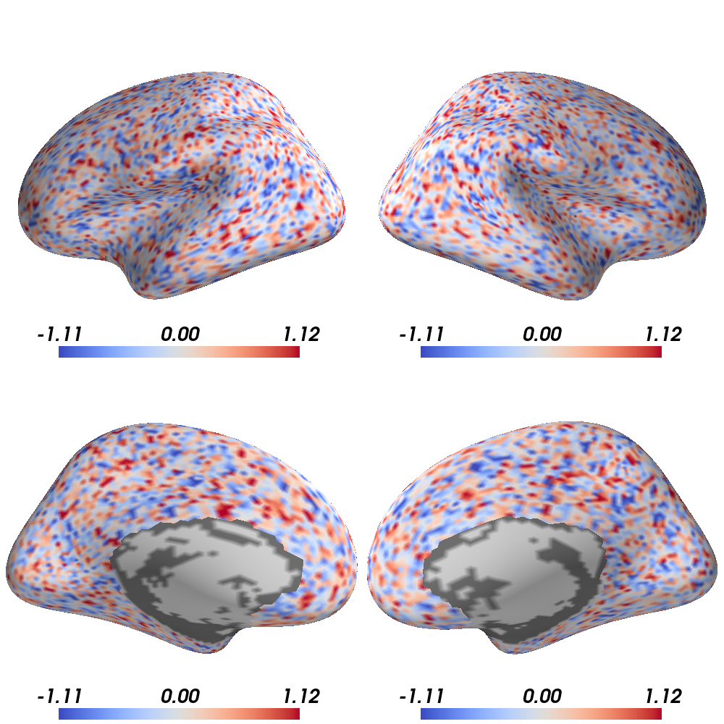
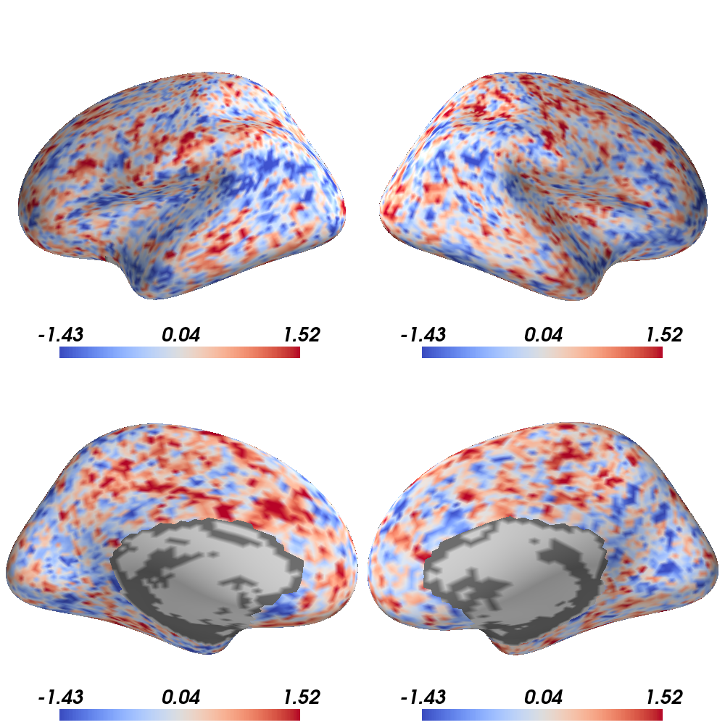
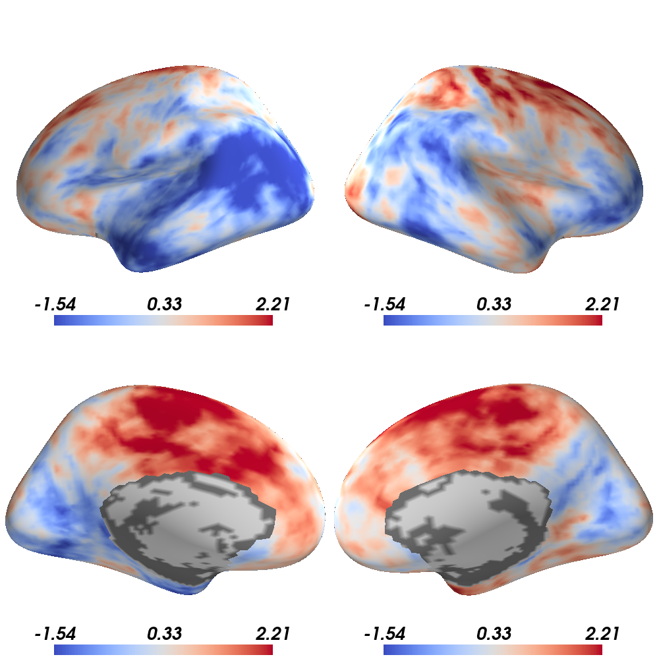
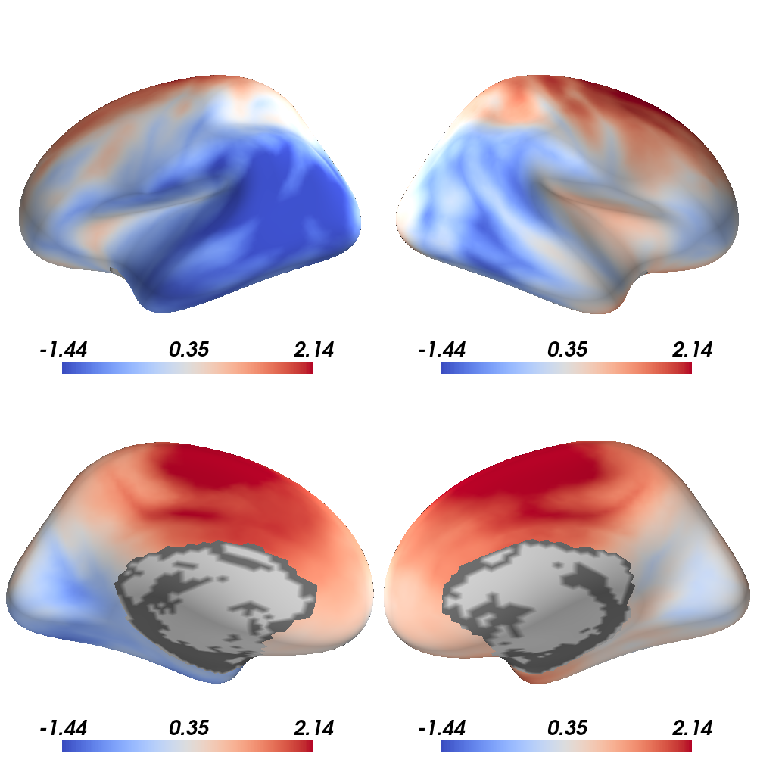
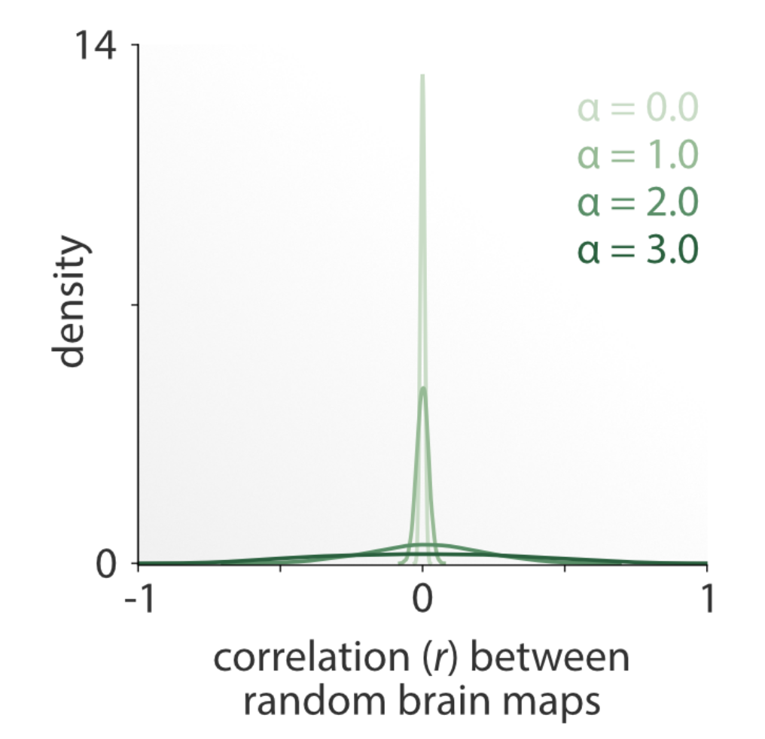
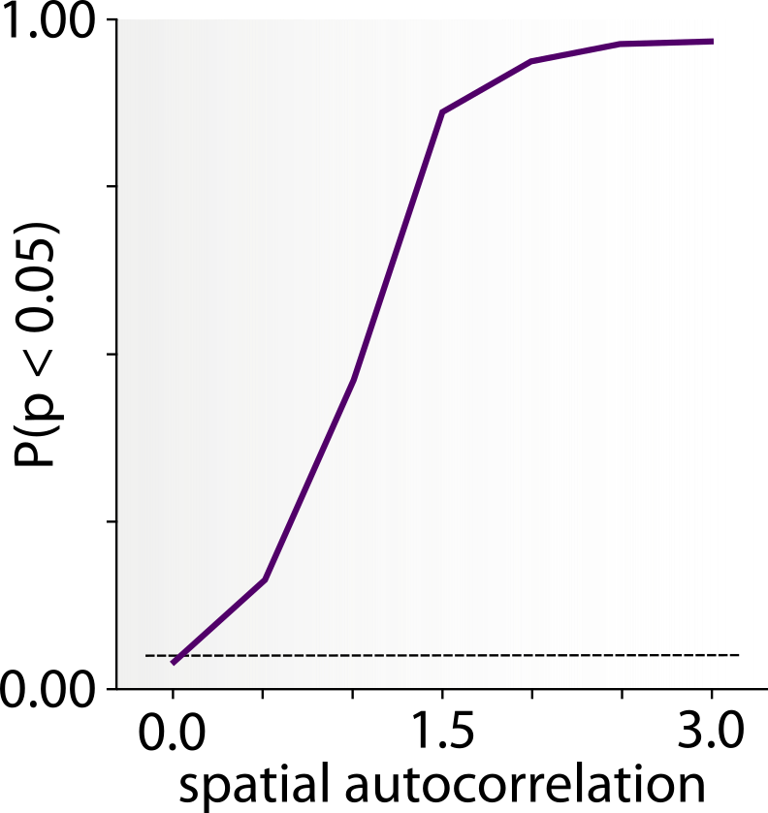
neur maps: spatial nulls
Correlating spatially-autocorrelated brain maps yields inflated p-values:
increasing smoothness
α = 0.0
α = 1.0
α = 2.0
α = 3.0
r=0.00
r=-0.05
r=-0.65
r=-0.90
Markello et al. (2021) NeuroImage
14

Slide 31
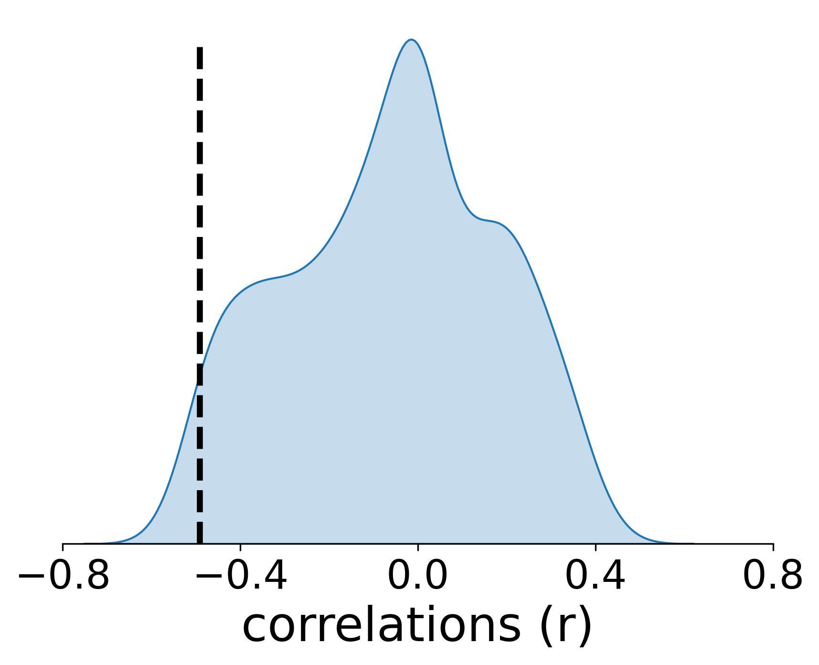
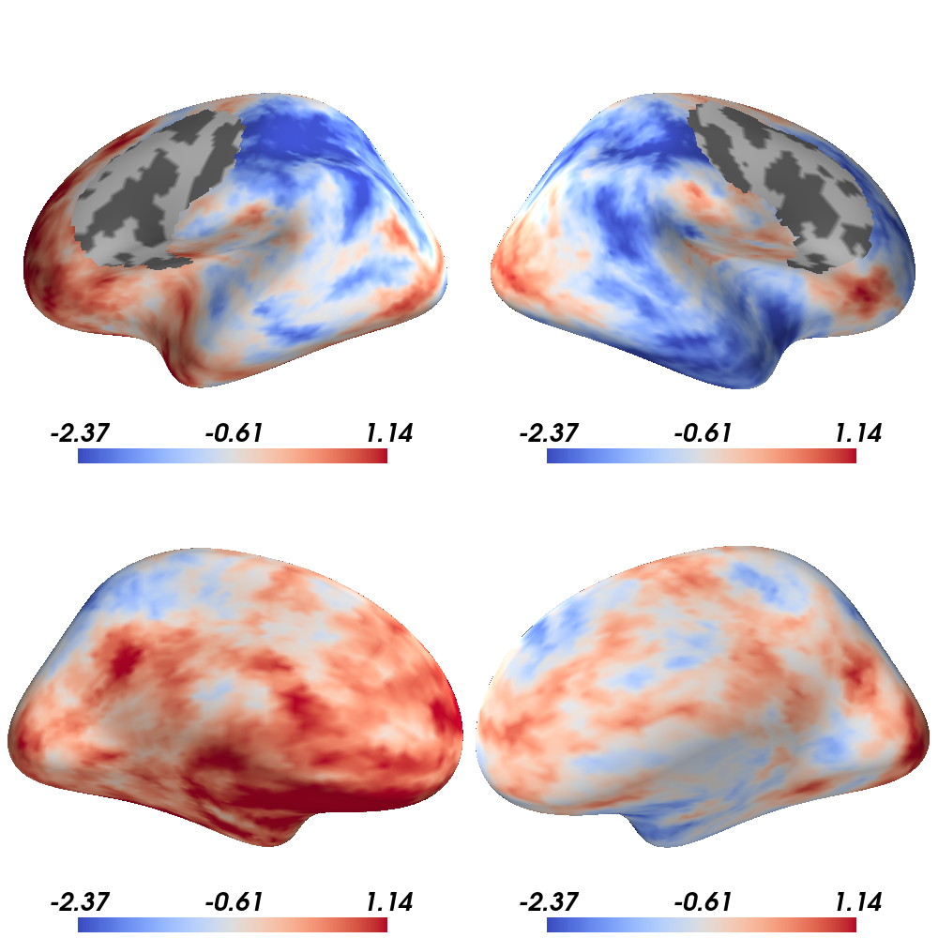
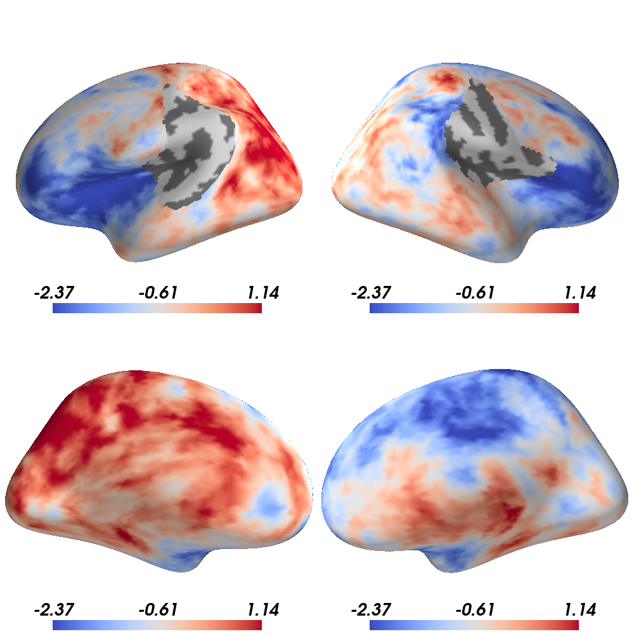
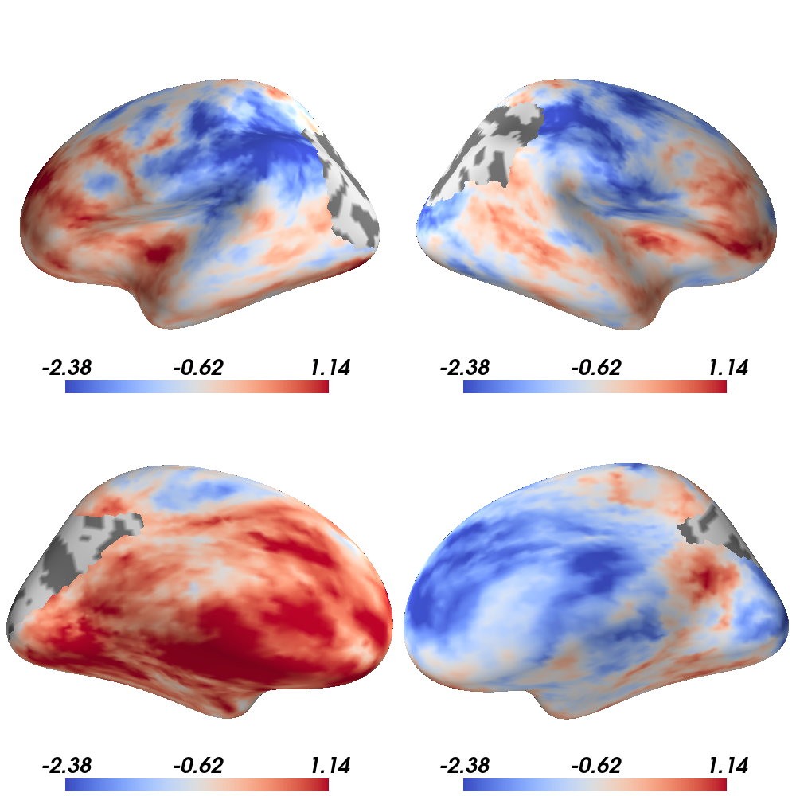
neur maps: spatial nulls
We need statistical tests that control for spatial autocorrelation:
Permutation testing
X
Y
Correlate two brain maps (X and Y)
Generate 1,000 null maps from Y
Correlate X with each null map
Count # of null correlations ≥ r_{X,Y}
Normalize by 1,000 to get a p-value
# of p ≤ 0.05 is our FWER
r = -0.65
Y_{null}
r = 0.24
p = 0.06
r = -0.32
r = 0.41
Markello et al. (2021) NeuroImage
15

Slide 32




neur maps: spatial nulls
How do we generate surrogate brain maps?
Markello et al. (2021) NeuroImage
16

Slide 33
neur maps: spatial nulls
How do we generate surrogate brain maps?
e.g. Student’s t-distribution
e.g. permutation test
Markello et al. (2021) NeuroImage
16

Slide 34

neur maps: spatial nulls
How do we generate surrogate brain maps?
Alexander-Bloch et al. (2018) NeuroImage | Baum et al. (2020) PNAS | Cornblath et al. (2020) Communications Biol | Vasa et al. (2018) Cerebral Cortex
16

Slide 35

neur maps: spatial nulls
How do we generate surrogate brain maps?
Burt et al. (2018) Nature Neuroscience | Burt et al. (2020) NeuroImage | Vos de Wael et al. (2020) Communications Biology
16

Slide 36
neur maps: spatial nulls
Which model to choose?
Markello et al. (2021) NeuroImage
17

Slide 37
neur maps: spatial nulls
Which model to choose?
Give inflated p-values: not recommended!
Markello et al. (2021) NeuroImage
17

Slide 38
neur maps: spatial nulls
Which model to choose?
require surface-based data
Give inflated p-values: not recommended!
Markello et al. (2021) NeuroImage
17

Slide 39
neur maps: spatial nulls
Which model to choose?
require surface-based data
Give inflated p-values: not recommended!
work with both surface- and volumetric-based data
Markello et al. (2021) NeuroImage
17

Slide 40
neur maps: spatial nulls
Which model to choose?
“imperfect permutations”
(may have some duplicates)
perfect permutations
Markello et al. (2021) NeuroImage
17

Slide 41
neur maps: spatial nulls
Which model to choose?
incomplete permutations
(medial wall moved into brain map)
Markello et al. (2021) NeuroImage
17

Slide 42
neur maps: spatial nulls
Which model to choose?
works for both parcellated and vertex-level data
for parcellated data only
Markello et al. (2021) NeuroImage
17

Slide 43
neur maps: spatial nulls
Which model to choose?
works for both parcellated and vertex-level data
for parcellated data only
In theory: works for both parcellated and voxel/vertex-level data
In practice: hard to implement at the voxel/vertex level (takes days to generate the nulls + 100s of GB of temporary storage space)
17

Slide 44

neur maps: spatial nulls
It is worth it?
Definitively: False Positive rates drastically decrease with spatial autocorrelation-preserving nulls
Note: Parameterized nulls are slightly less statistically accurate than spatial permutation nulls
Markello et al. (2021) NeuroImage
18

Slide 45
neur maps: the workflow
18

Slide 46

neur maps: spatial nulls
How do we contextualize brain maps?
19

Slide 47


neur maps
pip install neuromaps
Also available as a docker container
find a bug or have a question? Open an issue on GitHub
contribute to our open code and data
github.com/netneurolab/neuromaps
Justine Hansen
Ross D Markello
collaborators & contributors
Zhen-Qi Liu
Golia Shafiei
Laura E Suarez
Nadia Blostein
Jakob Seidlitz
Sylvain Baillet
Ted Satterthwaite
Mallar Chakravarty
Armin Raznahan
Bratislav Misic
documentation

Slide 48
Contextualizing human brain maps
What do we need to contextualize our brain map?
Toolbox to make easy, statistically-rigorous comparisons between brain maps
Python interface for fetching and working with the Allen Human Brain Atlas (AHBA) microarray expression data
20

Slide 49

Contextualizing human brain maps
Allen Human Brain Atlas microarray data
tissue samples gathered from 6 post-mortem human brain
ran microarray analysis on cRNA probes acquired from each sample
ultimately: RNA expression for more than 20,000 genes, taken across 3702 spatially distinct tissue sample
Hawrylycz et al. (2012) Nature
21

Slide 50

Contextualizing human brain maps
Allen Human Brain Atlas microarray data
How do we pre-process this data?
Hawrylycz et al. (2012) Nature | Arnatkeviciute et al. (2019) NeuroImage
22

Slide 51
Contextualizing human brain maps
Allen Human Brain Atlas microarray data
How do we access this data?
we can download complete normalized microarray datasets from the website
we can use their API, to query the specific dataset that we want
or we can use abagen:
Python interface for fetching and working with the Allen Human Brain Atlas (AHBA) microarray expression data
Markello et al. (2021) eLife
23

Slide 52


Contextualizing human brain maps
Allen Human Brain Atlas microarray data
How do we access this data?
With one function call, we can have access to pre-processed gene expression data. All we need is either:
a parcellation
a brain mask
Markello et al. (2021) eLife
24

Slide 53


Contextualizing human brain maps
Allen Human Brain Atlas microarray data
How do we access this data?
It can also generate densely-interpolated expression maps
It incorporates multiple methods for missing data
Markello et al. (2021) eLife
25

Slide 54

Contextualizing human brain maps
Allen Human Brain Atlas microarray data
Abagen handles the various processing steps for you:
Markello et al. (2021) eLife
26

Slide 55
collaborators & contributors
thank you!
Bratislav Misic
Zhen-Qi Liu
Golia Shafiei
Laura E Suarez
Nadia Blostein
Jakob Seidlitz
Sylvain Baillet
Ted Satterthwaite
Mallar Chakravarty
Armin Raznahan
Aurina Arnatkeviciute
Jean-Baptiste Poline
Ben Fulcher
Alex Fornito
Ross D Markello
Github repository: github.com/netneurolab/neuromaps
documentation: netneurolab.github.io/neuromaps
Github repository: github.com/rmarkello/abagen
documentation: abagen.readthedocs.io

